Slide 1





KICKSTARTER CROWD FUNDING ANALYSIS
Group Members: Sreehari P K
Angel Mary Mamidi
Naveen Goli
Manjusha N M
Himanshu Ambhore

Slide 2




Tools used
Excel:
Utilized for initial data exploration, cleaning, and basic analysis. Excel charts and pivot tables were created to visualize KPIs.
Tableau:
Employed for creating interactive and visually appealing dashboards. Various charts, including bar charts, funnel charts, and maps, were utilized to present KPIs effectively.
Power B I:
Utilized for creating dynamic and interactive dashboards. Power BI allowed for seamless integration of multiple data sources and the creation of visually appealing reports.
SQL:
Executed for data manipulation, filtering, and aggregation to derive key metrics. SQL queries
were essential for preparing datasets for visualization.

Slide 3
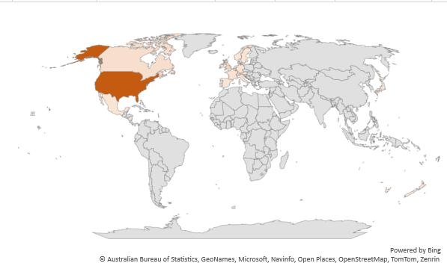
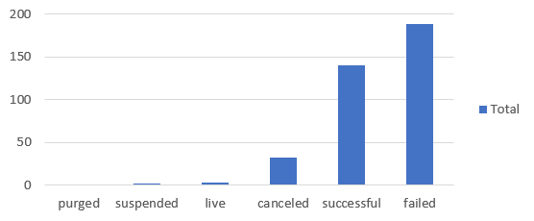
KPI- Visuals
KPI-1 Projects Based on Outcome
KPI-2 Projects Based on Location

Slide 4
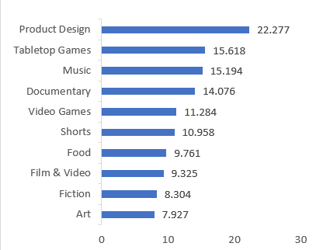
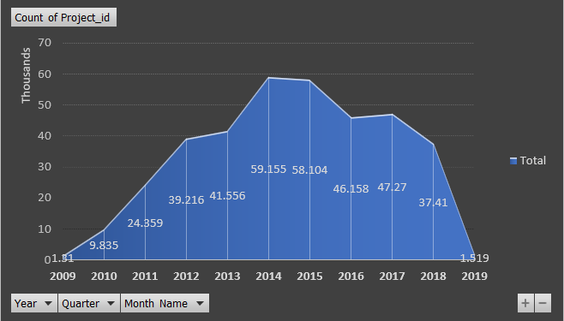
KPI- Visuals
KPI-3 Projects Based on Category
KPI-4 Projects By Year, Quarter, Month

Slide 5
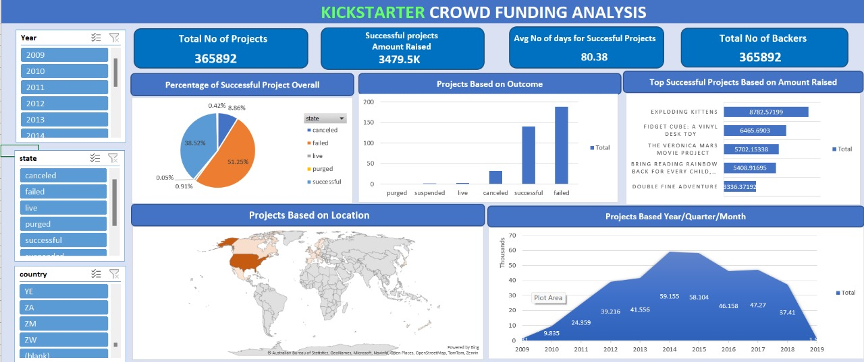
Excel Dashboard

Slide 6
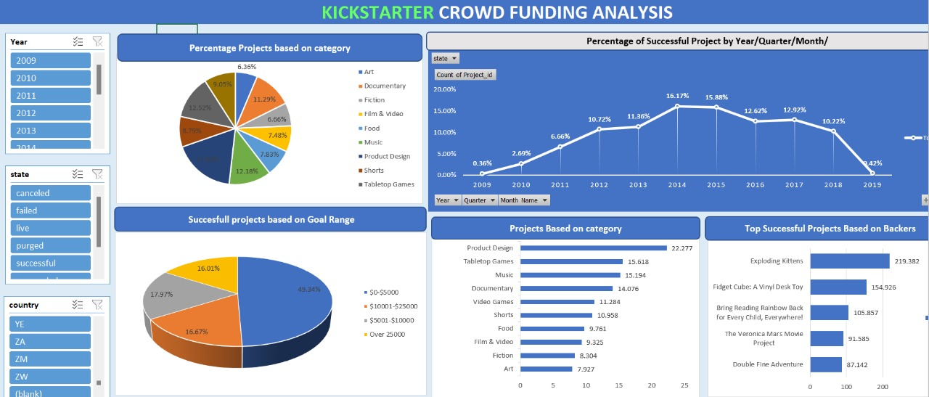
Excel Dashboard

Slide 7
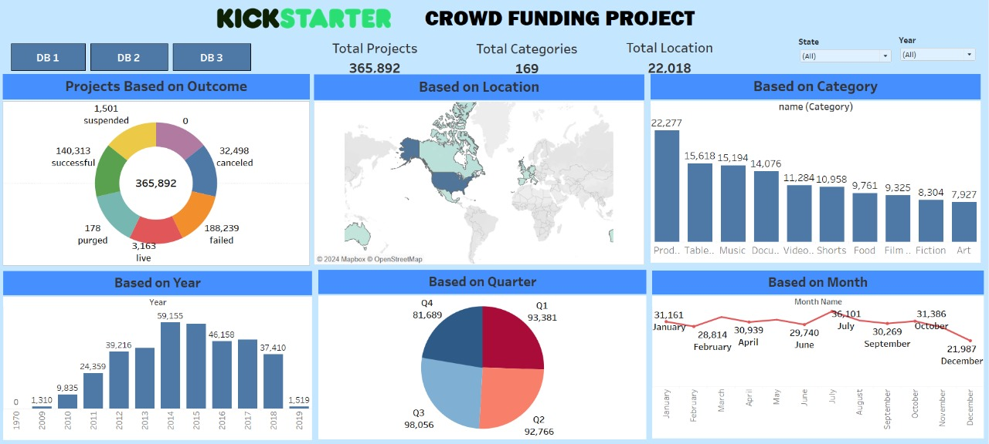
Tableau Dashboard

Slide 8
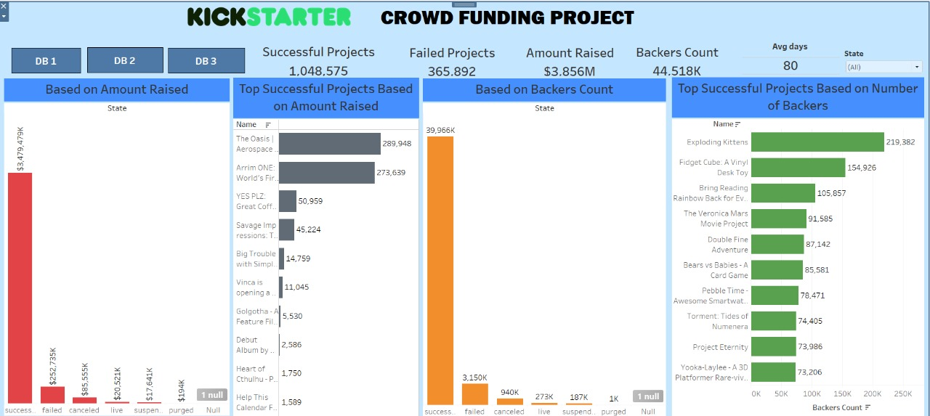
Tableau Dashboard

Slide 9
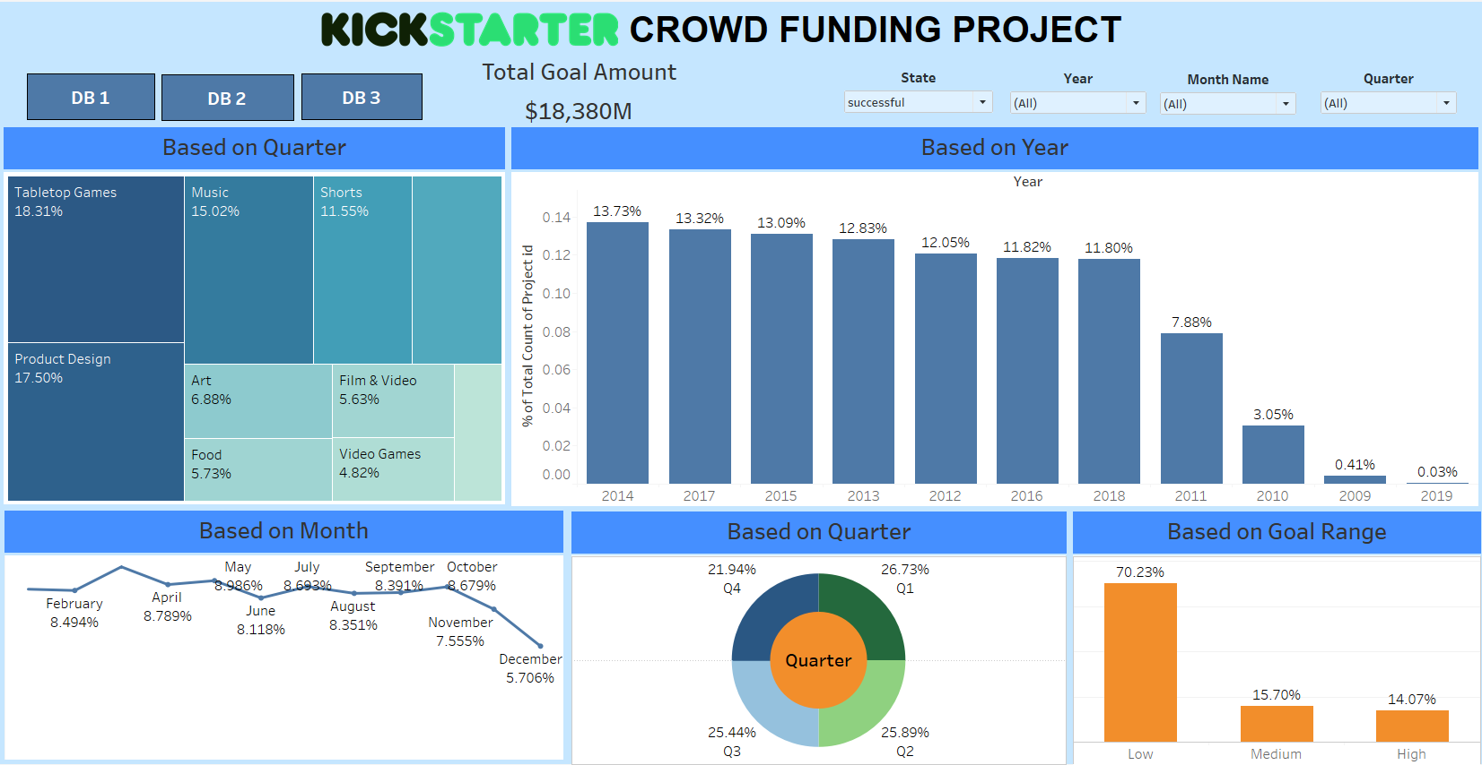
Tableau Dashboard

Slide 10
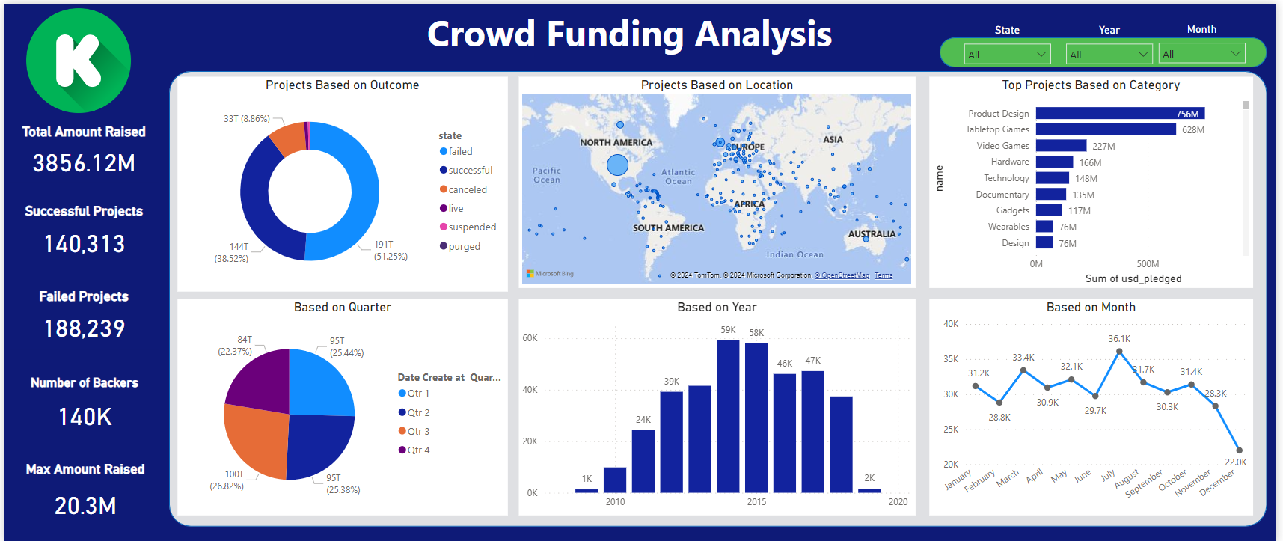
Power BI Dashboard

Slide 11
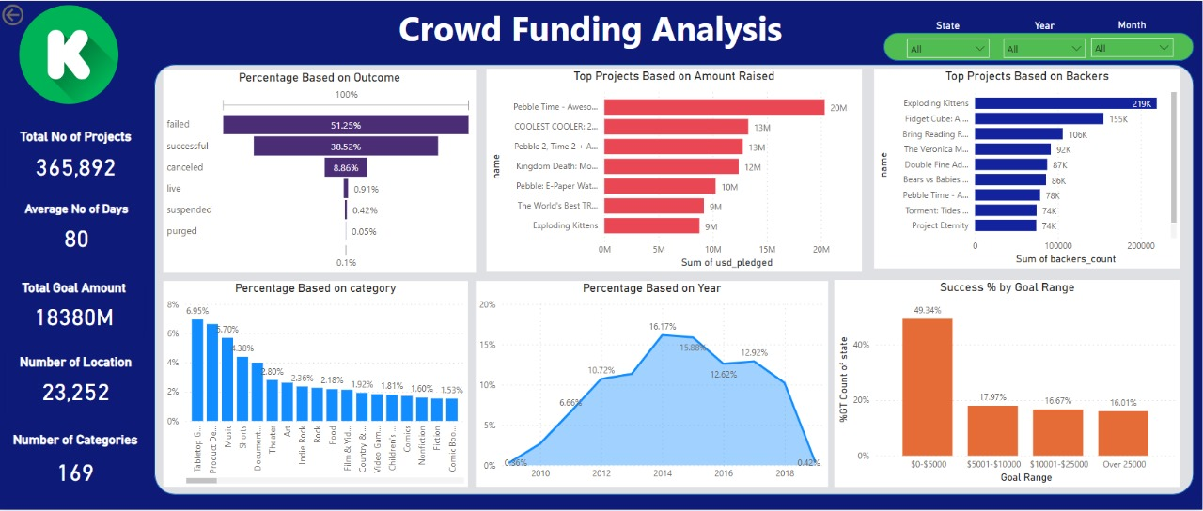
Power BI Dashboard

Slide 12
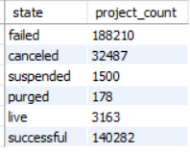
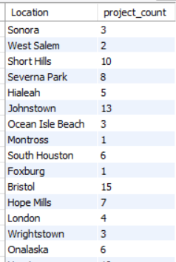
SQL
KPI-1 Projects Based on Outcome
KPI-2 Projects Based on Location
SELECT state, COUNT(*) AS project_count
FROM projects
GROUP BY state;
SELECT l.name as Location, COUNT(p.ProjectID) AS project_count
FROM projects p
INNER JOIN location l
ON p.location_id = l.location_idGROUP BY l.name;

Slide 13
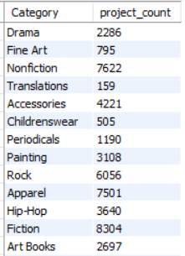
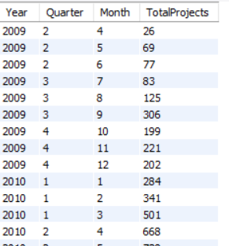
SQL
KPI-3 Projects Based on Category
KPI-4 Projects By Year, Quarter, Month
SELECT c.name, COUNT(p.ProjectID) AS project_count
FROM projects p
INNER JOIN category c
ON p.category_id = c.category_id
GROUP BY c.name;
SELECT
YEAR(FROM_UNIXTIME(created_at)) AS Year,
QUARTER(FROM_UNIXTIME(created_at)) AS Quarter, MONTH(FROM_UNIXTIME(created_at)) AS Month, COUNT(*) AS TotalProjects
FROM
projectsGROUP BY YEAR(FROM_UNIXTIME(created_at)), QUARTER(FROM_UNIXTIME(created_at)), MONTH(FROM_UNIXTIME(created_at))
ORDER BY
Year, Quarter, Month;

Slide 14
Recommendation
To expand globally, improve marketing to attract more creators from other countries
Beyond 60 days, there's a risk of declinig interest, so consider concise campaigns for optimal results
Encourage tailored marketing, community engagement, and innovative approaches within these categories to enhance project visibility and chances of success
Aligning project with this optimal funding bracket increases the likelihood of achieving funding targets
Explore successful projects from 2014 to identify shared characteristics, offering insights into factors contributing to their success
Cultivate a robust community engagement strategy to foster support and enthusiasm for your project

Slide 15
CONCLUSION
In conclusion, achieving success on Kickstarter requires a multifaceted approach. It involves broadening your reach globally to tap into diverse markets, strategically timing your campaigns for approximately 30 days to maintain momentum, selecting project categories with proven popularity to capture interest, setting attainable funding goals to inspire confidence in backers, analyzing historical data to inform your strategy, striving for noteworthy recognition to enhance credibility, and actively involving the community to foster genuine support and excitement for your project.

Slide 16
THANK YOU

